Slide 1
Networking: 420-A32 encryption

Slide 2
Encryption & Decryption
Encryption is the use of an algorithm to scramble data into a format that can be read only by reversing the algorithm (decrypting).
The purpose of encryption is to keep information private
Cryptography is the study of creating and using encryption and decryption techniques
Plaintext is the data before encryption
Ciphertext is the data after encryption
Notes:
Encrypted using an encryption algorithm

Slide 3
Key encryption
The key is the unique piece of information that is used to create ciphertext and decrypt the ciphertext back into plaintext.
A key is a random string of characters.
Keys are used to generate a unique data block.
The longer the key, the harder it is for an unauthorized system to decrypt it.

Slide 4
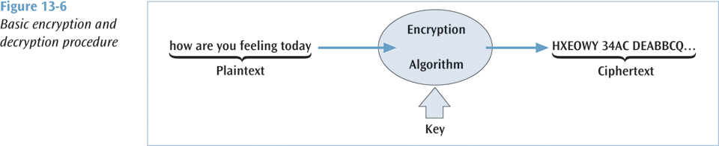
Basic Encryption

Slide 5
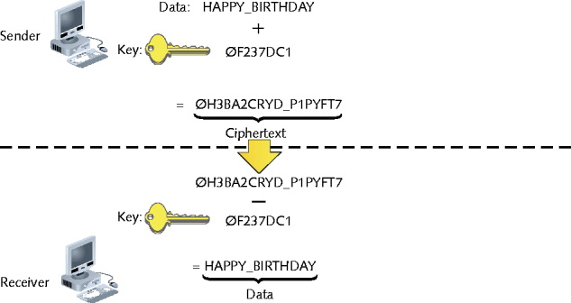
Private Key Encryption – 1 key
Figure 12-6 Key encryption and decryption

Slide 6
Private key encryption
Data is encrypted using a single key that only the sender and receiver know.
Also called symmetric encryption since the same key is used during both encryption and decryption.

Slide 7
Private vs public key Algorithms
Private key encryption algorithms:
DES
Triple DES (3DES)
AES
Public key encryption algorithms
RSA
RC4

Slide 8
Data Encryption Standard (DES)
Created in 1977, standard took a 64-bit block of data and subjected it to 16 levels of encryption
The choice of encryption performed at each of the 16 levels depends on the 56-bit key applied
Even though 56 bits provides over 72 quadrillion combinations, a system using this standard has been cracked (in 1998…in 3 days)

Slide 9
Triple DES
A more powerful data encryption standard
Data is encrypted using DES three times: the first time by the first key, the second time by a second key, and the third time by the first key again
Virtually unbreakable, but CPU intensive
For smart cards, cell phones, and PDAs, a faster (and smaller) piece of code needed

Slide 10
Advanced Encryption System (AES)
National Institute of Standards and Technology selected the algorithm Rijndael (pronounced rain-doll) in October 2000 as the basis for AES
AES has more elegant mathematical formulas, requires only one pass, and was designed to be fast, unbreakable, and able to support even the smallest computing device

Slide 11
Advanced Encryption System
Key size of AES: 128, 192, or 256 bits
Estimated time to crack (assuming a machine could crack a DES key in 1 second) : 149 trillion years
Very fast execution with very good use of resources

Slide 12
Public Key Cryptography
Powerful encryption technique in which two keys are used: the first key (the public key) encrypts the message while the second key (the private key) decrypts the message
Not possible to deduce one key from the other
Not possible to break the code given the public key
If you want someone to send you secure data, give them your public key, you keep the private key
Notes:
User sends request for secure connection to server
Server returns a certificate with its public key and variety of encryption algorithms
User selects an algorithm and generates a set of keys – keeps one, encrypts other and sends it back using server Public Key
Server uses own private key to decrypt user’s public key
Now they can talk in secure manner

Slide 13
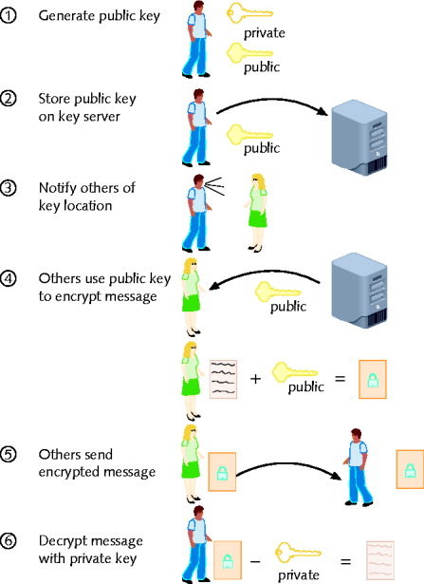
Figure 12-8 Public key encryption

Slide 14
Digital Signatures
Document to be signed is sent through a complex mathematical computation that generates a hash
Hash is encoded with the owner’s private key then stored
To prove future ownership, stored hash is decoded using the owner’s public key and that hash is compared with a current hash of the document
If the two hashes agree, the document belongs to the owner
Notes:
Now legal currency in court, etc.

Slide 15
Public Key Infrastructure (PKI)
The combination of encryption techniques, software, and services that involves all the necessary pieces to support digital certificates, certificate authorities, and public key generation, storage, and management
A certificate, or digital certificate, is an electronic document, similar to a passport, that establishes your credentials when you are performing transactions

Slide 16
Public Key Infrastructure (PKI)
A digital certificate contains your name, serial number, expiration dates, copy of your public key, and digital signature of certificate-issuing authority.
Certificates are usually kept in a registry so other users may check them for authenticity.

Slide 17
Public Key Infrastructure (PKI)
Certificates are issued by a certificate authority (CA). A CA is either specialized software on a company network or a trusted third party
Let’s say you want to order something over the Internet. The web site wants to make sure you are legit, so the web server requests your browser to sign the order with your private key (obtained from your certificate)

Slide 18
Public Key Infrastructure (PKI)
The web server then requests your certificate from the third party CA, validates that certificate by verifying third party’s signature, then uses that certificate to validate the signature on your order
The user can do the same procedure to make sure the web server is not a bogus operation
A certificate revocation list is used to “deactivate” a user’s certificate

Slide 19
Public Key Infrastructure - Apps
Applications that could benefit from PKI:
World Wide Web transactions
Virtual private networks
Electronic mail
Client-server applications
Banking transactions

Slide 20
PGP (Pretty Good Privacy)
Secures e-mail transmissions
Developed by Phil Zimmerman (1990s)
Administered at MIT
Public key encryption system
Verifies e-mail sender authenticity
Encrypts e-mail data in transmission
Freely available
Open source and proprietary
Also used to encrypt storage device data

Slide 21
SSL (Secure Sockets Layer)
Encrypts TCP/IP transmissions
Web pages, Web form data entered into Web forms
En route between client and server
Using Public key encryption technology
Web pages using HTTPS
HTTP over Secure Sockets Layer, HTTP Secure
Data transferred from server to client (vice versa)
Using SSL encryption
HTTPS uses TCP port 443

